Slide 1
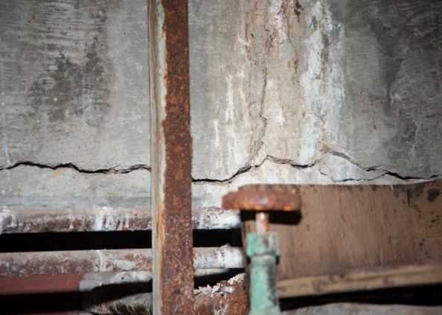
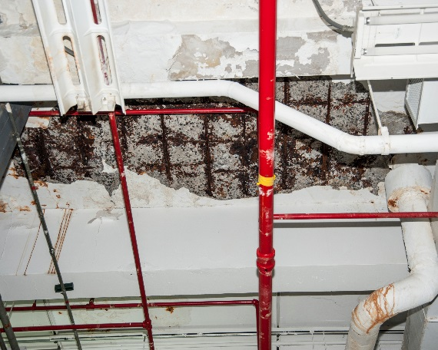
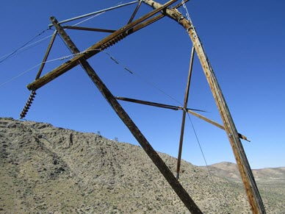
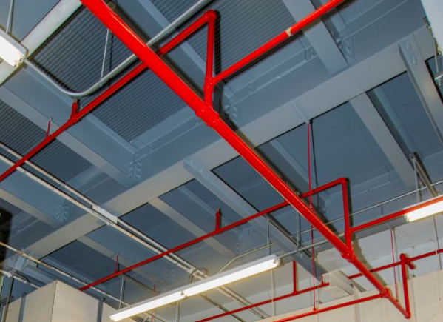
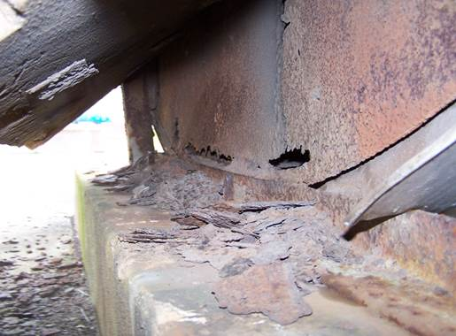
Infrastructure Restoration
Progress is being made…
Y-12 Building 9204-2
Y-12 Building 9204-2
Y-12 Beta-2 Facility
Pantex Electrical Distribution
SRS 238-H Supply Fan
NNSS Power Lines
but much work still remains…

