Slide 1
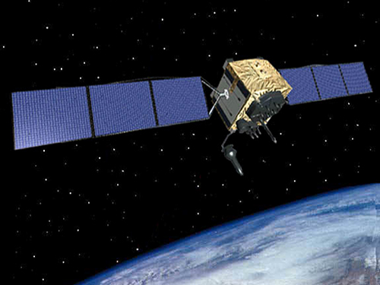
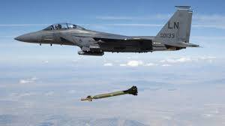
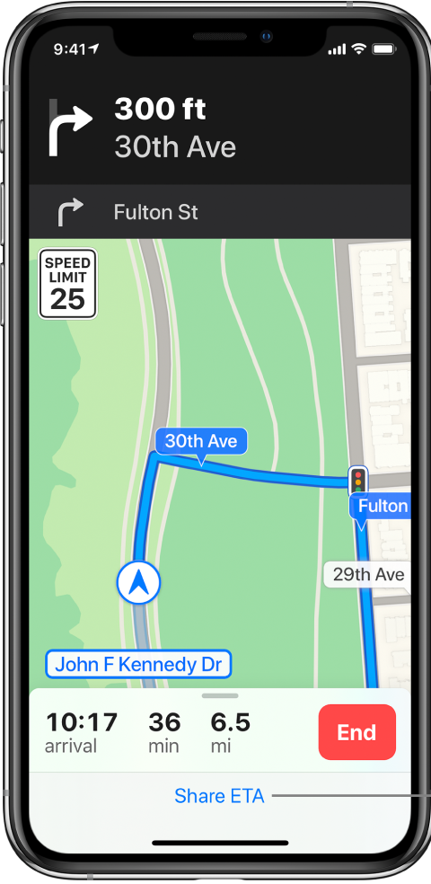
What’s at Risk?
How is GPS at Risk?
GPS infrastructure designed under ground rules intended for sharing with satellite operations and services (low power).
Signals from space are extraordinarily weak; a Ligado base station is much stronger than GPS and overwhelms GPS signal
FCC wants to move the goal posts by allowing terrestrial transmitters in a space communications band despite unanimous Federal opposition.
Federal agency testing and analysis prove interference with GPS receivers will occur.
National impact; ceding GPS world primacy and a $100+B industry to China and Russia.
Replacement of U.S. GPS base is a huge opportunity.
Adversary systems (BeiDou, GLONASS) unaffected.
Developed for DoD, today the military is a minority user of GPS.
GPS touches almost every part of the world economy; forecast to be a $146.4B industry by 2025.
Mythbusters
GPS Signal vs. Ligado Noise
Myth: Ligado is critical to the U.S. 5G build-out.
Fact: Ligado has < 3% of sub-6 GHz spectrum in use today; Ligado’s presence or absence will make no significant difference in U.S. 5G.
Myth: DoT testing was flawed; it did not assess receiver performance against a Ligado transmitter.
Fact: DoT testing addressed protection of the assigned GPS band for all receivers, not a scenario dependent, artificial environment of one receiver and one transmitter.
Myth: Ligado stations are like a 10 W bulb; cannot interfere with GPS.
Fact: Power in the assigned band is what matters. A 10 W bulb is 350 dB brighter than objects the Hubble Telescope can see, and will totally blind it. To a GPS receiver, a 10 W in-band transmitter is 170 dB “brighter” than a GPS signal, and will “blind” it.
Noise: Jet Takeoff (140-150 dB)
Signal: Leaves Rustling. (0-10 dB)
Noise: Jet Takeoff (140-150 dB)
Signal: Leaves Rustling. (0-10 dB)
0 dB = barely audible sound
Every 10 dB increase = factor of 10 power increase; i.e., 20 dB = 10X the power of 10 dB, 30 dB = 100X the power of 10 dB, etc.
0 dB = barely audible sound
Every 10 dB increase = factor of 10 power increase; i.e., 20 dB = 10X the power of 10 dB, 30 dB = 100X the power of 10 dB, etc.
With GPS, We are Trying to Hear Rustling Leaves…
GPS
Receiver
GPS
Receiver
Through the Noise of 100 Jets
Through the Noise of 100 Jets

